Slide 1
Strings
Slides by Varick Erickson
© Varick Erickson

Slide 2
Objectives
Identify the differences between c-strings and C++ string objects
Know the basic usage of c-strings
Know the basic usage of C++ string objects

Slide 3
Strings
There are two different ways to represent strings in C++
Character array → c-string
std::string → C++ string object
You will frequently encounter both types of strings when programming in C++.
TLDR: If you have a choice between a c-string and a std::string, you should use a std::string

Slide 4
c-string
char greeting[10] = "hello"; // c-string
'h' | 'e' | 'l' | 'l' | 'o' | '\0'
0 | 1 | 2 | 3 | 4 | 5 | 6 | 7 | 8 | 9
A c-string is a character array
The end of the string is marked using a null terminal character
If you want to examine a character, you use the string like an array.
cout << greeting[0] << endl; // prints h

Slide 5
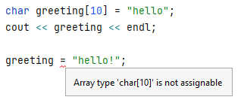
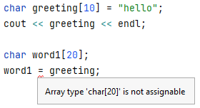
Limitations of c-string
Since c-strings are arrays, there are some limitations.
Can’t use assignment
Need to ensure array is appropriately sized

Slide 6
What is the output?
int main() { char word1[20] = "hello"; char word2[20] = "hello"; if (word1 == word2) { cout << "They are equal" << endl; } else { cout << word1 << " and " << word2 << " are NOT equal" << endl; } }
Notes:
Why are they not equal?

Slide 7
c-string Functions
Function | Description
strlen(char *str) | Returns the length of the string str
strcat(char *dest, char *src) | Copies the string src to the string dest.
int strcmp(const char *str1, const char *str2) | Compares str1 to str1. Returns 0 if equal, a negative value if str1 < str2, and a positive value if str1 > str2.
char *strncpy(char *dest, const char *src, size_t n) | Copies the first n characters from src to dest.

Slide 8
int main() { char word[100] = "hello world"; cout << "\"" << word << "\" has " << strlen(word) << " characters" << endl; char word1[20] = "hello"; char word2[20] = "hello"; if (strcmp(word1, word2) == 0) { cout << "They are equal" << endl; } else { cout << word1 << " and " << word2 << " are NOT equal" << endl; } }

Slide 9
std::string
std::string is an object that can represent a string.
std::string is generally easier to use than a c-string and does not have the same limitations as a c-string.
Able to use assignment operator
Able to compare
Dynamically resizes to fit the size of the string
Many convenience functions

Slide 10
length() and size()
The length and size functions both return how many characters are in a given string.
There is no difference between the functions.
string str = "Hello"; cout << str << " has " << str.length() << " letters" << endl; cout << str << " has " << str.size() << " letters" << endl;

Slide 11
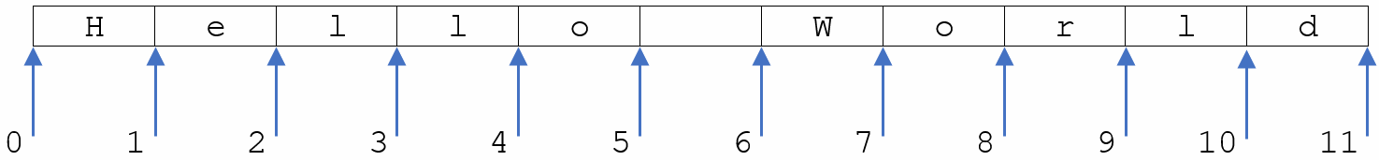
substring(int start, int end)
str = "Hello World";
cout << str.substr(0, 5) << endl;
cout << str.substr(6, str.length()) << endl;

Slide 12
Looping through a string
str = "Hello World"; for (int i = 0; i < str.length(); i++) { cout << str[i] << endl; }
In some instances, you may find is necessary to loop through a string and examine all the characters in a string.

Slide 13
Empty String
There is a special string called the empty string.
This is a string with no characters and has a length of 0.
There are many instances where you will start with an empty string and then append or concatenate values to the empty string.
string str = "";

